Slide 1
What is a Database?
Good Question!

Slide 2
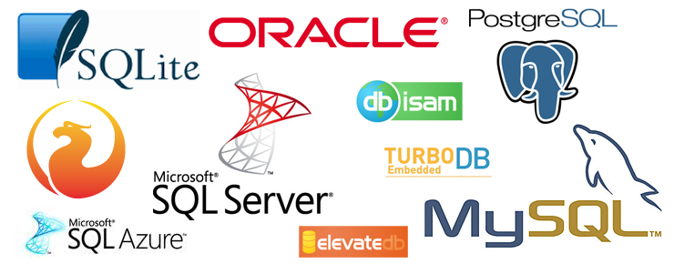
Types of Databases

Slide 3
SQL
SELECT column1, column2 FROM table1, table2 WHERE column2='value’;
SELECT Cust_No, First_Name FROM Customers WHERE Last_Name='Smith’;
SELECT First_Name, Nickname FROM Friends WHERE Nickname LIKE '%brain%';

Slide 4
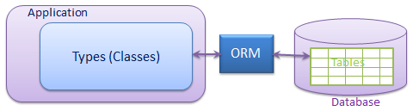
ORM
Object-Relational Mapping (ORM) is a technique that lets you query and manipulate data from a database using an object-oriented paradigm

Slide 5
Databases in Practice on a Node stack
https://expressjs.com/en/guide/database-integration.html
https://github.com/Automattic/mongoose

Slide 6
What is an API?
Another Good Question!

Slide 7
Definition
Application programming interface
An API isn’t the same as the remote server — rather it is the part of the server that receives requests and sends responses.

